Slide 1
Don’t Let Them See My Flaws
Exploring the Intersection of Perfectionism, Body Image and Eating Disorders
Dr. Sarah Pegrum Phd/MPsych (Clinical), Peer Reviewed Trainer
Jennifer Kemp M(Psych)Clinical
https://youtu.be/bgeLislRCko

Slide 2
Disclosures
Dr Sarah Pegrum
I have not received and will not receive any commercial support related to this presentation.
Jennifer Kemp
I have not received and will not receive any commercial support related to this presentation.
I receive royalties from New Harbinger Publications for the sale of books and consulting fees for services provided to other organisations on this topic.

Slide 3
Introduction to the Presenters
Dr. Sarah Pegrum
Phd/MPsych (Clinical), Peer Reviewed Trainer
drsarahpegrum@outlook.com
Jennifer Kemp
M(Psych)Clinical
jennifer@adelaidebehaviourtherapy.com.au

Slide 4
Today’s agenda
Understanding eating disorders, body image concerns and perfectionism from a CBS perspective
Towards a process-based approach for treatment

Slide 5
Set your intention
Something you’d like to learn (head)
Something you’d like to gain personally (heart)
Something you’d like to practice (hands)

Slide 6
Understanding eating disorders, body image concerns and perfectionism from a CBS perspective

Slide 7
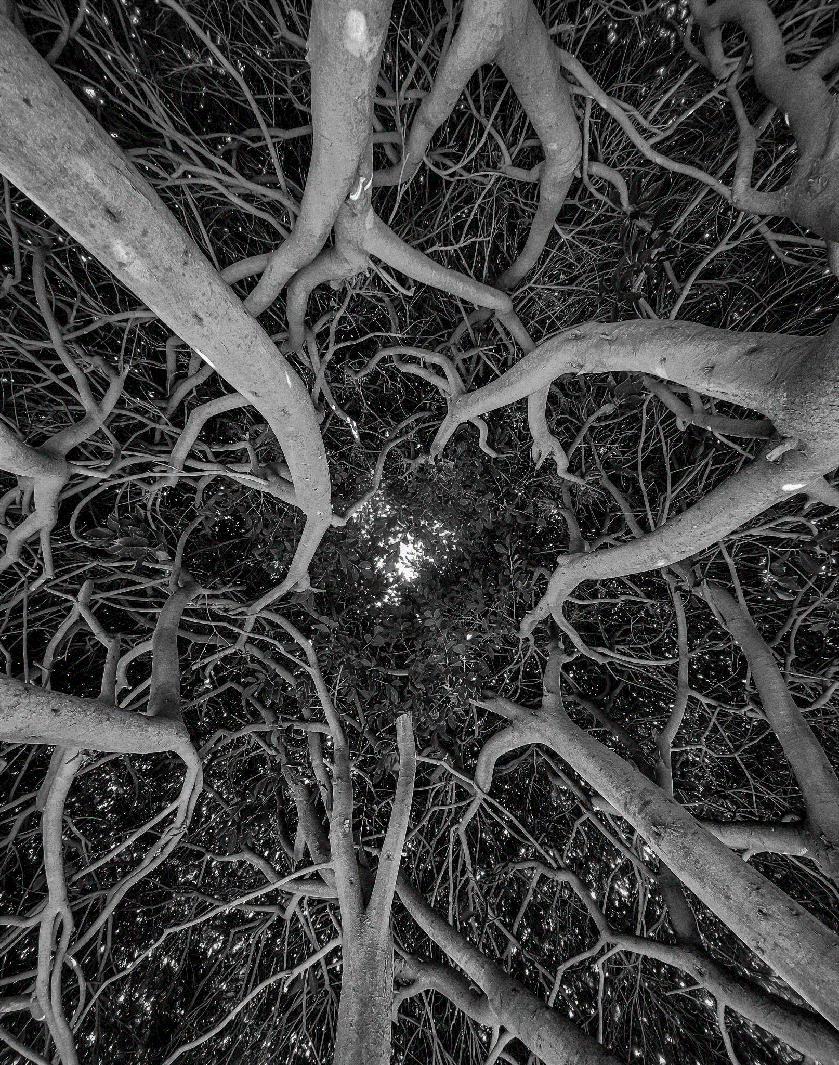
There is a close relationship between perfectionism, eating disorders and body image disturbance
Issues commonly co-occur
Using a CBS lens, we can understand the common processes that tie these problems together
Understanding this better will support treatments
…and open possible research avenues

Slide 9
Evolutionary Processes
Animals use appearance to gather useful information
Information about whether there is a threat, illness, or a potential ally or aid or mate
Tuned to the negative
By noticing the negative or threat and responding, the species survives and thrives
To the victor goes the spoils
Whether it is food, resources or a mate, animals that demonstrate being ‘the best’ get the rewards

Slide 10
Language Relations

Slide 11
Modern Context
Certain appearances are idolized, while others are feared and vilified
Diet/Wellness culture/Fitspo
Fat phobia
Achievement & success is highly reinforced
Failure or not good enough is punished and shamed

Slide 12
So what are the common processes at the heart of perfectionism, eating disorders & body image disturbances?
Perfectionism
?
Body
Image
Concerns
Eating
Disorders

Slide 13
Common behavioral processes
Rigid, impossible standards for success
Destructive self-criticism
Fear of failing
‘Self’ defined by the ability to achieve standards
Persistent attempts to achieve standards, avoid failure & self-criticism, despite this causing long-term problems

Slide 14
Rigid, impossible standards
Standards become rigid rules
Specific weight goal
Specific body shape
Specific achievement/grade
Standards are raised over time
Lower weight goal
Even ‘better’ body shape
Absolute success/fail standards

Slide 15
Destructive self-criticism
Self-criticism is relentless, mean and follows us everywhere
It controls our behaviour
Never meeting own standards, we never feel good enough

Slide 16
Fear of failure
The definition of failure is unique to the individual
Social
Weight
Appearance
Performance…
We must avoid failing to avoid self-judgement & self-criticism

Slide 17
Fear of failure
If I fail, then I am (or will be perceived as):
Not good enough
Incompetent
Unworthy
Out of control
Stupid
Useless
Weak
Unlovable…

Slide 18
‘Self’ defined by the ability to achieve standards
How we feel about ourselves (and what we can do) becomes defined by whether we can achieve our standard
“When I am thin I will…”
“I am lazy & hopeless”
Creates high pressure to achieve, and shame when unable to achieve

Slide 19
Naturally we try to avoid failure and self-criticism
Experiential Avoidance
We will do anything to get away from self-criticism and failure.

Slide 20
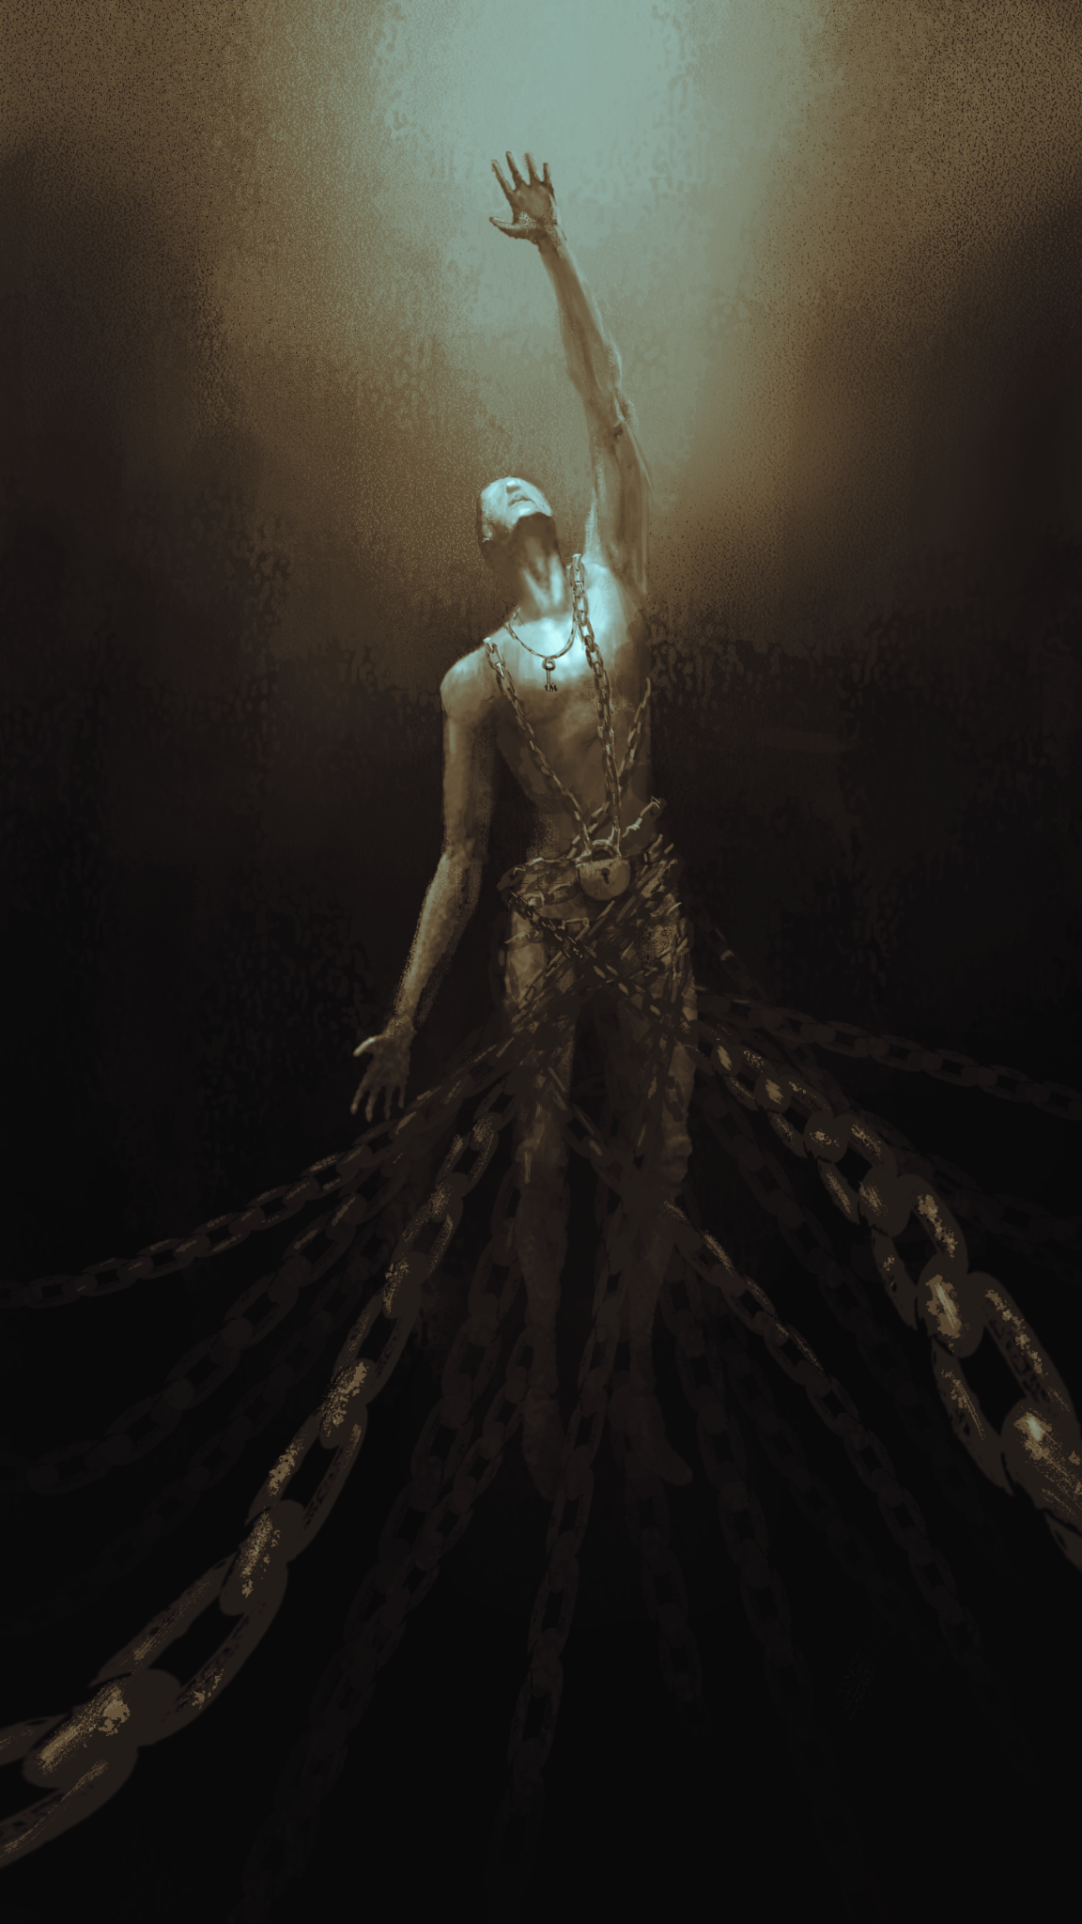
This is known as ‘behaviour under aversive control’
Behaviour under aversive control is behaviour that is under the control of things we want to move away from.
Characterised by behaviours that are:
‘Running, fighting & hiding’
Rigid, inflexible
Rule-bound

Slide 21
Active Avoidance
Behaviours aimed at struggling/fighting to get rid of or fix the ‘problem’
Problem is perceived as being connected to self
Examples; overworking/striving to achieve, dieting, surgery

Slide 22
Passive Avoidance
Behaviours aimed at running or hiding
Often brings initial relief as moves the person away from what is feared
Examples; quitting, avoid social situations, avoid mirrors

Slide 23
The patterns cause long-term problems
Avoidance may bring short term relief but there are long-term costs
You tend to get what you most fear:
Binge/purge cycles lead to weight gain
Urgency to perform leads to procrastination or burnout
Social anxiety leads to isolation or rejection
Serious physical health problems can also occur

Slide 24
Formulation Sheet
Context & Standards
Self criticism
Failure & avoidant behaviours
Action/Intervention points
Potential barriers

Slide 25
Towards a process-based approach to treating eating disorders, body image concerns and perfectionism

Slide 26
There are many possible directions for treatment
Addressing context?
Can be helpful to build compassionate understanding of self
Tackling rigid standards?
Tend to have obsessional quality
Defusion may be more helpful
Building motivation?
‘Creative Hopelessness’
Values to guide and maintain action

Slide 27
Time is always limited
Effective treatment means addressing the key processes that cause the most suffering and maintain unworkable patterns

Slide 28
Which processes have the greatest impact?
There are three priorities for treatment that will expand the person’s behavioral repertoire & build psychological flexibility:
Broadening the ‘self’ by externalizing the problem
Unwind avoidant behaviors, and
Develop skills in self-compassion

Slide 29
The goal is to broaden behavioural flexibility in the presence of the aversive

Slide 30
1. Broadening the ‘Self’ by Externalising the Problem

Slide 31
When the ‘self’ becomes tied to the ‘problem’ it shuts down flexibility & values
Locked in the current struggle now, future opportunities aren’t visible
Values remain unclear
Change seems impossible

Slide 32
Externalizing the problem provides access to values and future-oriented thinking
There are several ways to externalize the problem through:
Language
Metaphors
Images or art
Objects & space

Slide 33
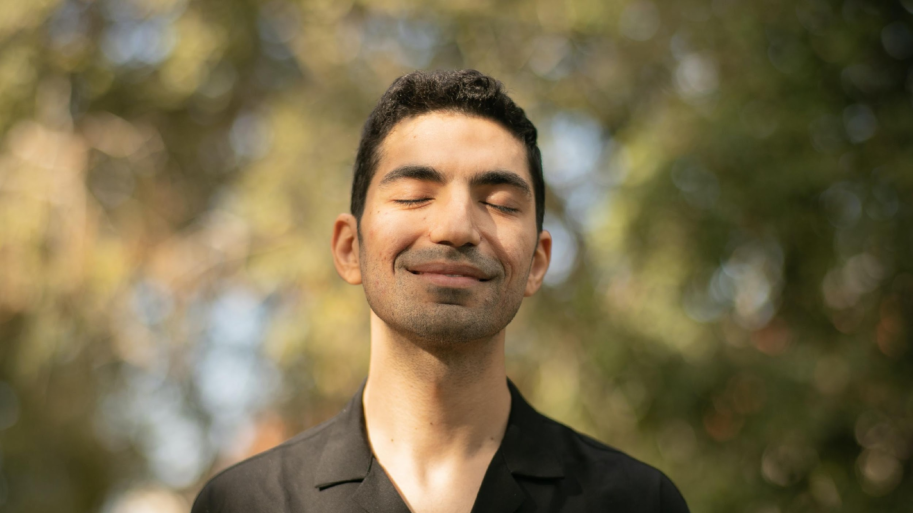
Activity
You will need pen & paper
Notes:
This exercise is private, you will not be expected to share your experiences.
Start this exercise with a blank piece of paper and pen in front of you. (Needs to be a physical piece of paper, not digital.)
Eyes closed activity:
Imagine you are sitting opposite/beside the part of you that critiques your body & performance
This is the part of you that critiques & nit-picks all the time, what you do, what you say, how you look, what you eat… it’s list of criticisms is endless
It is a relentless fault-finding machine.
Imagine you could hear it speaking to you now. Imagine how it might criticize you and what it might say. Or, if your criticism is pretty quiet right now, think back to something that happened recently where you criticised yourself harshly.
Hear the unkind and unwanted things it says to you.
Take a moment to write down several unkind things your self-critic might say at the top of the page. Notice how you feel in your body when you hear it say these things.
Now, with eyes closed again, imagine you had this critical part of yourself sitting beside you right now. If it had a physical form, what would it look like?
Remember that while you may have learned this voice from someone else, it is now your inner voice. It is not someone else that you know, it is your inner critic.
Now, either draw a picture or write a brief description of how your inner critic looks.
Fold your piece of paper in half, twice. Then take this piece of paper and place it on the chair next to you, across the table, or on the floor; somewhere just out of reach, separate to you.
Notice what it feels like to separate yourself from this part of yourself. Notice any sensations or emotions that arise.
Larger group debrief: What did you notice?

Slide 35
Unwinding Avoidant Behaviours

Slide 36
Building flexibility means exposing yourself to your fears
Inner experiences you are avoiding
Fears, doubts, and uncertainty
Ambivalence
The possibility of failure or rejection…
Are you willing to feel uncomfortable if choosing this will help you to move towards your valued future?

Slide 37
The ‘Why’ (Values)
To change unhelpful habits, we need to have a good reason
After all, in the short term these habits offer us relief
Living a valued life is the bigger goal

Slide 38
Willingness
Being willing to have the full experience of life, even the unwanted and uncomfortable parts
Willingness is a skill
Can have an all or nothing quality
To be willing, you need to remember why you are doing this

Slide 39
Practicing Willingness
Wear mismatched socks all day
Go to the gym with your shirt inside out
Eat a new food you’ve never tried
Eat something you know you don’t like
Leave one bite of food on your plate
Smile at a stranger
Listen to music you wouldn’t normally listen to
Ask your boss for feedback

Slide 40
Practicing Willingness
Wear something inappropriate for the occasion
Take a different route to work or school
Try a new sport
Speak up at a meeting
Stand in the rain without an umbrella
Go out without putting on make-up or brushing your hair
Set your alarm 30 minutes earlier and get out of bed for no reason (!!)

Slide 41
Curiosity
We can lose the ability to wonder at the small things in adulthood
Building your capacity to be curious about your inner world is essential to lessening the grip of perfectionism & body anxiety

Slide 42
Curiosity
More like a dial than a switch
You can ‘dial up’ your curiosity about your inner experiences
“What do you notice?”
“What shows up?”

Slide 43
Unwanted and uncomfortable physical sensations you might notice with curiosity
Physical Location | Common Sensations
In your chest and torso: | Tension Tightness Heaviness Restlessness
In your stomach: | Churning/Twisting Nausea/sick feeling Lurching Tension Heaviness Falling/sinking/dropping
Elsewhere in your body: | Muscle tension in head, shoulders, back, legs, neck or arms Agitation/restlessness/shakiness Headache Mind racing or foggy Hands fidgeting

Slide 44
Practicing Willingness & Curiosity
STEP 1
Consider WHY it could be helpful to be more comfortable with your appearance
Reverse your phone camera and look at yourself
Notice how you may curate your own image & experience of this

Slide 45
Practicing Willingness & Curiosity
STEP 2
Now, sneek a peek at a part of your body that you feel uncomfortable with
Hold your focus there…
Notice what shows up including thoughts, emotions and urges to stop

Slide 46
Practicing Willingness & Curiosity
STEP 3
Would you be willing?
Take an uncensored, unposed photo right now, and share this on your socials
#seemyflaws
#ACBSWC
Notice any contributions from your self-critic, feelings and physical sensations that show up as you do this.

Slide 47
Developing the skills of self-compassion

Slide 48
Despite the pain it causes, we often believe that self-criticism is necessary
I need to be self-critical to motivate myself. Without this, I will be lazy and unproductive.
I need to criticize myself to improve my performance.
If I don’t criticize myself, I will just make the same mistakes again.
Self-compassion would make me too weak, soft, selfish, or vulnerable.
I don’t deserve to be kinder to myself.
I don’t know how to be kinder to myself.

Slide 49
Your self-criticism has a good intention for you*
*And a really sh*tty way of going about it

Slide 50
What if you could soften the way you speak to yourself?
The Two Teachers Metaphor
(Gilbert, 2009; Kolts, 2016)

Slide 51
Offering Compassion to Your Inner Critic

Slide 52
Thank You
Thank you!

